Slide 1

Poison
Ciaran Darcy

Slide 2
POISON
Types of Poison
Methods of Poisoning
Recognition of Poisoning
Treatment of Poisoning
Special Cases

Slide 3
POISON STATISTICS
9911 poisoning cases in 2008
57.3% of cases were accidental
25.1% intentional
89.9% occured in the home
Most cases involved drugs

Slide 4
POISON STATISTICS CHILDREN
Children younger than 4 years of age were involved in 45.7% of the cases, and 50.3% involved children younger than 9 years of age.
The most common forms of poison exposure for children under the age of six are cosmetics and personal care products, cleaning substances, medicines and foreign bodies.
Although children under the age of six are the most likely to be exposed to poison, they represent just 2 percent of poison fatalities.
Only 20 of 920 fatalities involved children under 6 years of age, and of these, 10 involved household substances.

Slide 5
POISON STATISTICS TEENAGERS
In children between ages 10 and 19, the majority of poison exposures (59%) involve girls.
In children under 13, the reverse is true; over 56 percent of these exposures involve boys.
89.5 percent of reported adolescent deaths from poison exposure were due to intentional poison exposure such as suicide or drug abuse.

Slide 6
POISON STATISTICS ADULTS
Over 60 percent of all poison fatalities occur in adults ages 20 to 49.
While adults 60 and over account for just over 4 percent of poison exposures, they account for 14.4 percent of the fatalities.

Slide 7
POISON
What is a Poison?

Slide 8
POISON: What is a Poison?
Everything is poison, there is poison in everything. Only the dose makes a thing not a poison (Paracelus)
Poisons are substances that can cause injury, illness, or death to organisms, usually by chemical reaction or other activity on the molecular scale, when a sufficient quantity is absorbed by an organism. (Wikpedia)
Any thing taken in sufficient quantities to alter the body's normal functioning state

Slide 9
POISON: Examples
Common types of poison
Plants:
Chemicals:
Drugs:
‘Poisons’:
Food Poisoning
Example
Yew, Hemlock,
Bleach, Paint Stripper
Pain-killers, Illegal drugs, Overdoses, Alcohol, Glue
Rat poison, Ant Killer

Slide 10
POISON: Method of Poisoning
Method
Injected
Ingested
Absorbed
Inhaled
Example
Drugs, Bites
Bleach, Food Poison
Plants, Chemicals
Gas, Solvents

Slide 11
POISON: INJECTED
Associated with drug abuse
Also caused by bites and/or stings
Poison goes deep into blood stream

Slide 12
POISON-INGESTED
Most common form of poisoning
Poison absorbed through assimilation (food breakdown)
Fastest acting poisons are ingested ones
Also some of the slower ones

Slide 13
POISON:INHALED
Becoming more common
Poison enters body through gaseous exchange in lungs
Not using proper ventilation while decorating
Carbon Monoxide Poisoning

Slide 14
POISON:ABSORBED
Poison is absorbed through the skin, eye, or elsewhere.
Usually associated with chemicals
If casualty has a wound near poison site the poison enters the blood stream faster
May have burns due to the poison

Slide 15
POISON RECOGNITION
Differs depending on poison:
Vomiting (possibly bloodstained)
Impaired consciousness
Pain or burning in throat, stomach
Empty Containers Nearby
History of exposure to poison

Slide 16
POISONING RECOGNITION
Aspirin (swallowed)
Upper abdominal pain, Nausea & vomiting
Ringing in the ears
"Sighing" when breathing
Confusion and delirium
Dizziness
Paracetamol (swallowed)
Little effect at first, but abdominal pain, nausea and vomiting may develop.
Irreversible liver damage may occur within 3 days (malnourishment and alcohol increase the risk)

Slide 17
POISONONG RECOGNITION
Tranquillisers (commonly ingested)
Lethargy and sleepiness, leading to unconsciousness.
Shallow breathing
Weak, irregular, or abnormally slow or fast pulse
Stimulants and hallucinogens (ingested)
Excitable, hyperactive behaviour, wildness and frenzy
Sweating
Tremor of the hands
Hallucinations

Slide 18
POISON RECOGNITON
Narcotics (commonly injected)
Small pupils
Sluggishness and confusion, possibly leading to unconsciousness
Slow, shallow breathing, which may stop altogether
Needle marks, which may be infected
Solvents (commonly inhaled)
Nausea and vomiting
Headaches
Hallucinations
Possibly, unconsciousness
Rarely, cardiac arrest

Slide 19
POISON TREATMENT
AIMS
To maintain the airway, breathing, and circulation.
To remove any contaminated clothing.
To identify the poison.
To arrange urgent removal to hospital

Slide 20
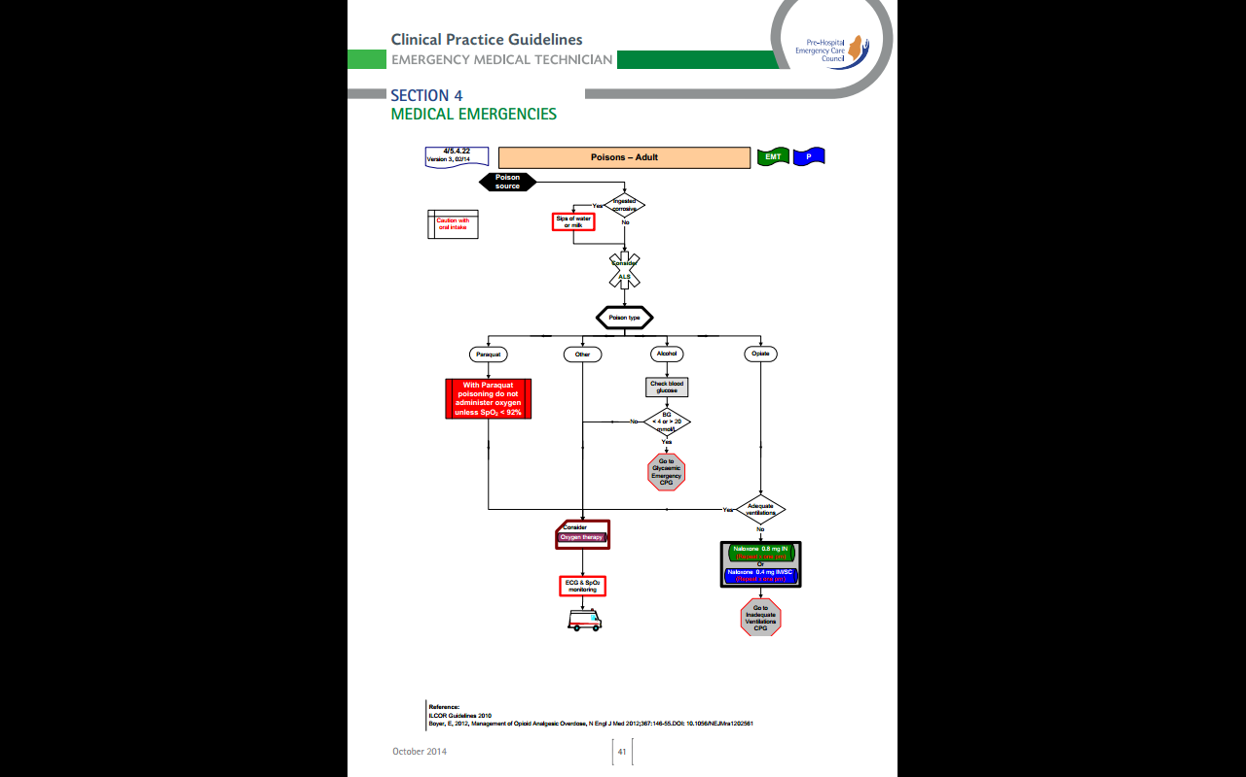
Poison Treatment

Slide 21
POISON TREATMENT
PROTECT YOURSELF
DO NOT INDUCE VOMITING
DO NOT INDUCE VOMITING

Slide 22
POISON TREATMENT
Conscious Casualty
Reassure
Ask what they took
AMBULANCE (Give as much information as you can about the poison)
Treat any other injuries (burns, cuts)
Look for samples of the poison
Try take samples of any vomited material for the hospital to look at
Give sips of Milk/water if lips are burned

Slide 23
POISON TREATMENT
Unconscious casualty
AMBULANCE
A B C
Consider Oxygen Therapy
If need be commence CPR
USE FACEMASK
Take samples of poison or drug

Slide 24
Food Poisoning
Caused by bacteria
In 2010 4500 cases reported in all Ireland
Actual figures may be lower due to lack of reporting of minor cases
However Ireland has one of the highest incidences of poisoning in Europe

Slide 25
FOOD POISONING
Nausea and vomiting.
Cramping abdominal pains.
Diarrhoea (possibly bloodstained).
Headache or fever.
Features of shock.
Impaired consciousness
RISK OF DEHYDRATION

Slide 26
FOOD POISONING
Advise the casualty to lie down and rest. Help them if necessary.
Give the casualty plenty of bland fluids to drink and a bowl to use if they vomit
Call a doctor for advice.
If the casualty's condition worsens
Dial 999 for an ambulance

Slide 27
CARBON MONOXIDE
Colourless, tasteless, odourless Gas
Occurs from fuel burning in cars, heaters etc
Adheres to red blood cells 300 times faster than Oxygen
Prevents oxygen reaching Vital Organs
Long term exposure can cause other problems
Approx 14 deaths per year in Ireland

Slide 28
Chronic Carbon Monoxide Poisoning
Long exposure to low level of CO+ can result in
Physical symptoms: headache, nausea, vomiting, muscle pain, joint pain, chronic fatigue, dizziness, numbness, tingling, vertigo
Cognitive / Memory Impairments: attention problems, multi-tasking problems, word-finding problems, short-term memory problems, verbal and/or visual deficits.

Slide 29
Chronic Carbon Monoxide Poisoning
Affective Disorders (emotional/personality effects): irritability, anxiety, lack of motivation, temper, loss of interest, sleep disturbance, impotence.
Sensory and Motor Disorders: blurry vision, double vision, buzzing in the ears, decreased co-ordination, speaking, eating and swallowing disorders.
Gross Neurological Disorders: seizures, inability to speak, balance problems, tremors

Slide 30
CARBON MONOXIDE
REGOGNITION
    Low levels.
Shortness of breath
Mild nausea
Mild headaches
    Moderate levels
Headaches
Dizziness
Nausea
Light-headedness
High levels of CO can be fatal causing death within minutes

Slide 31
CARBON MONOXIDE TREATMENT
FRESH AIR
Take casualty out of area of else open all windows and doors
Turn off all appliances that could possibly produce CO
Hospital

Slide 32
Paraquat Poisoning
Highly Toxic weedkiller,
Banned in Europe since 2007
Used in 70's on Marijuana Plants in Mexico causing chronic lung diseases
Metabolises Oxygen
Causes fibrous buildup in lung tissue
Linked to Parkinsons disease

Slide 33
Paraquat Poisoning---Recognition
Burns in throat
Coma
Difficulty breathing
Nosebleed
Seizures
Shock
Shortness of breath
Sore throat
Stomach pain
Vomiting, including vomiting blood

Slide 34
Paraquat Poisoning –- Treatment
Hospital
Do not give oxygen unless Sats are below 92%
Wash skin contact for 10/15 mins without scrubbing
Flush eyes if needed

Slide 35
Narcotic Posioning
607 Drug related deaths in ireland in 2011
365 from Overdoses
Generally derived from Opiates
Sleep inducer
60% of deaths male

Slide 36
Narcotic Posioning Recognition
Small pupils
Sluggishness and confusion, possibly leading to unconsciousness
Slow, shallow breathing, which may stop altogether
Needle marks, which may be infected
Drug Paraphenelia

Slide 37
Narcotic Posioning Treatment
As for Poisoning with one ammendment for EMTs
IF INADEQUATE RESPIRATIONS
EMTS MAY ADMINISTER
0.8 mg Naloxone repeated every 3 mins to a max of 2mg
Beware of fast reversal of symptoms

Slide 38
ALCOHOL POISONING
Impairment of physical and Mental functions
Can cause deep unconsciousness
        Risks
Choking on Vomit
Hypothermia
Misdiagnosis

Slide 39
Alcohol Poisoning Recognition
A strong smell of alcohol
Impaired Consciousness
Flushed, Moist Face
Deep Noisy Breathing
Full Bounding Pulse
Later Unconsciousness

Slide 40
Alcohol Poisoning Recognition
Later stages of unconsciousness
Dry, Bloated Face
Shallow Breathing
Weak, Rapid Pulse
Dilated Pupils Reacting Poorly To Light

Slide 41
Alcohol Poisoning Treatment
Keep Warm
Assess for any other injuries and treat as appropriate
LOOK OUT FOR HEAD INJURIES,MEDICAL CONDITIONS AND HYPOTHERMIA
Monitor and record vital signs until recovery or put into care of responsible person
Treat as for poisoning
Consider Blood Sugar issues:
      Glucagon/Glucose gel

Slide 42
BITES & STINGS
Some snakes, scorpions & spiders are poisonous
Not very common injuries here, more common abroad
“Fright Factor” speeds up flow of poison

Slide 43
BITES & STINGS RECOGNITION
Puncture Mark
Severe pain
Redness
Swelling
Nausea & Vomiting
Disturbed Vision
Increased Salivation & Sweating
Laboured Breathing

Slide 44
BITES & STINGS TREATMENT
Ambulance
Lie down
Reassure
Compress above wound
Immobilise limb
Note appearance of creature so correct antivenin can be given

Slide 45
Prevention is Best
Try not to have a case at home
Check all chemicals have child proof caps
Cook & Handle Food Properly
If using Glue or Spray paint use a well ventilated area
Check boilers and other CO producing appliances

Slide 46
REMEMBER
Poisoning is common in Ireland
Prevention better than cure
DO NOT INDUCE VOMITING
ABC
O2
Hospital if needed

Slide 47
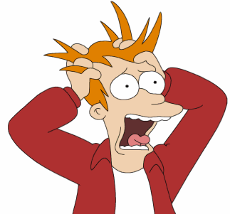
Questions

